Slide 1
Cyber Intelligence and the Dark Web
Karien Barsoum

Slide 2
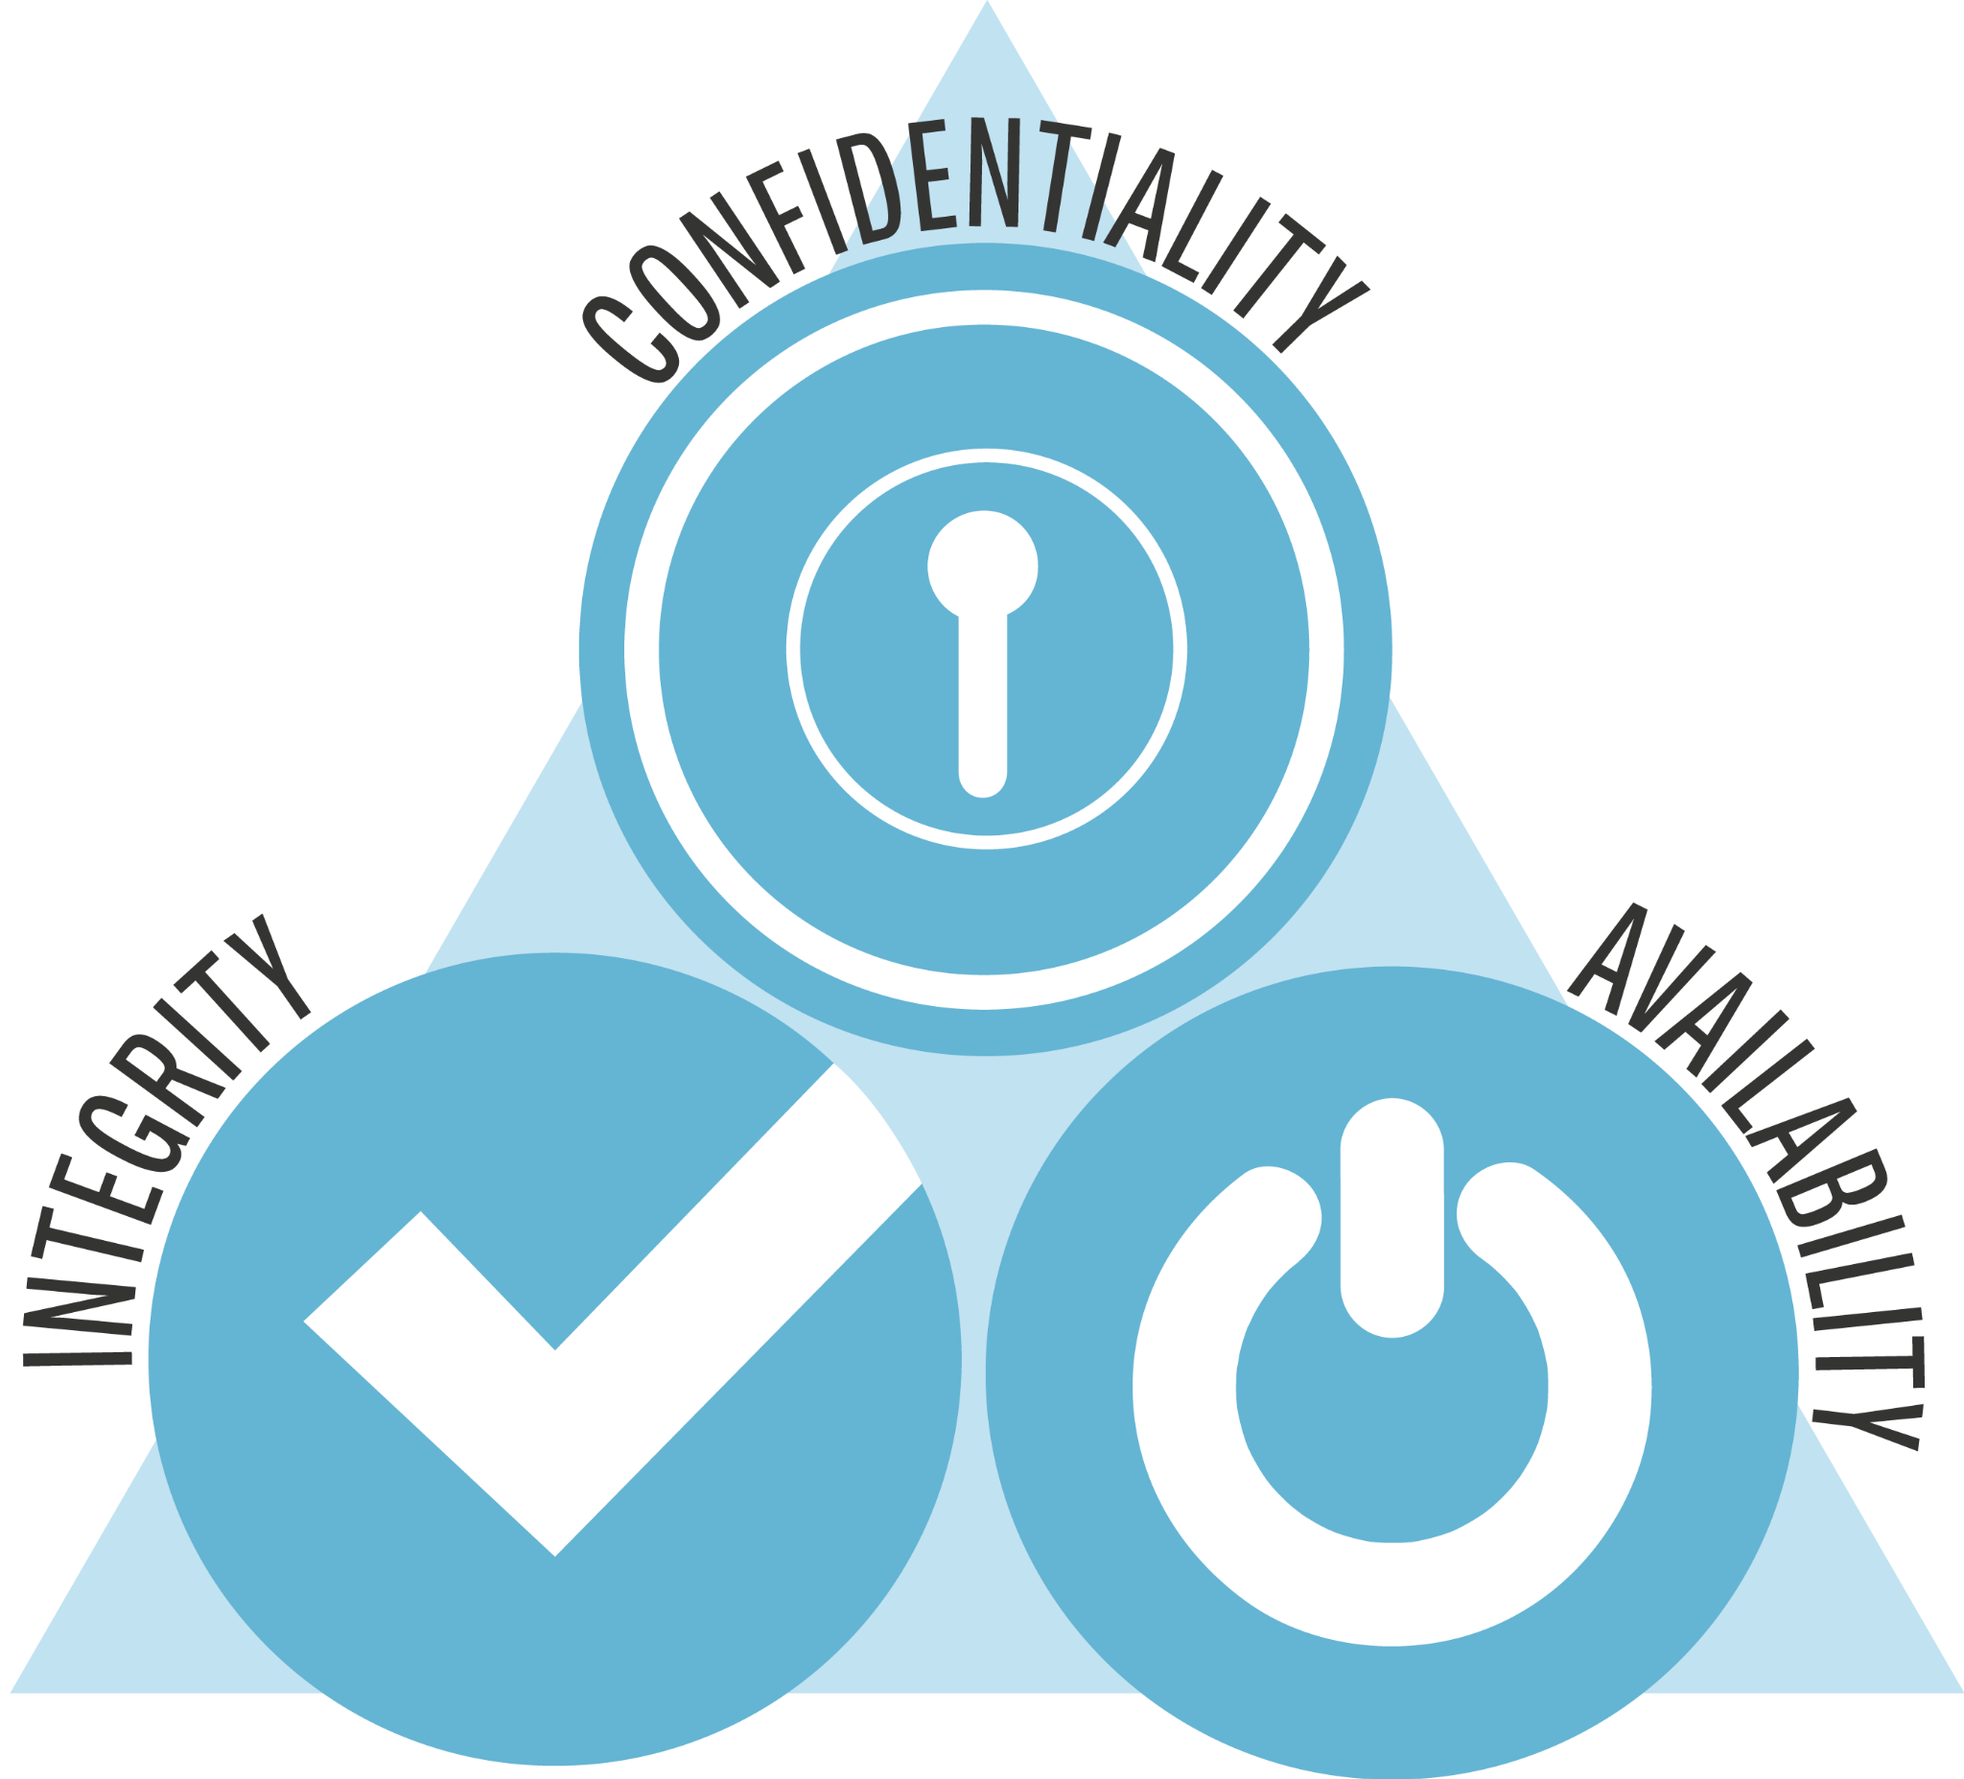
1a. What is Cybersecurity?
Combating threats
Protection from threats
Preventing threats
Actively defending networks, applications, devices, and data
Using threat intelligence
[1]
Notes:
Cybersecurity is the practice of protecting critical systems and sensitive information from digital attacks while threat intelligence is the process of collecting, analyzing and acting upon information about potential or current cyber threats. Cybersecurity focuses on protecting data from unauthorized access, ensuring the integrity of data, and making sure systems and data are available. [1]

Slide 3
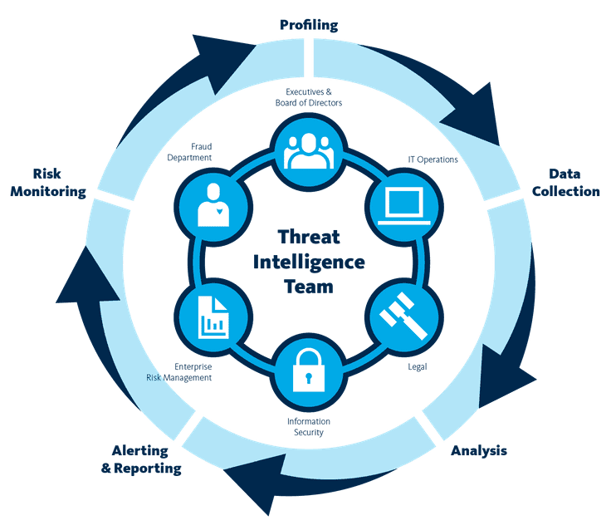
1b. How does it relate to threat intelligence?
Understand threat actor's motives online
Understand threat actor’s targets online
Gathering, processing and analyzing threat information
Typically aggregated in a single database
Used by Cybersecurity Professionals
[1]
Notes:
Threat intelligence is a huge aspect of maintaining the security of an organization. The goal of threat intelligence is to understand a threat actor's motives, targets and attack behaviors in order to better security decisions within an organization. Cybersecurity professionals use open source threat intelligence such as Security Technical Implementation Guides or Common Vulnerabilities and Exposures.[1]

Slide 4
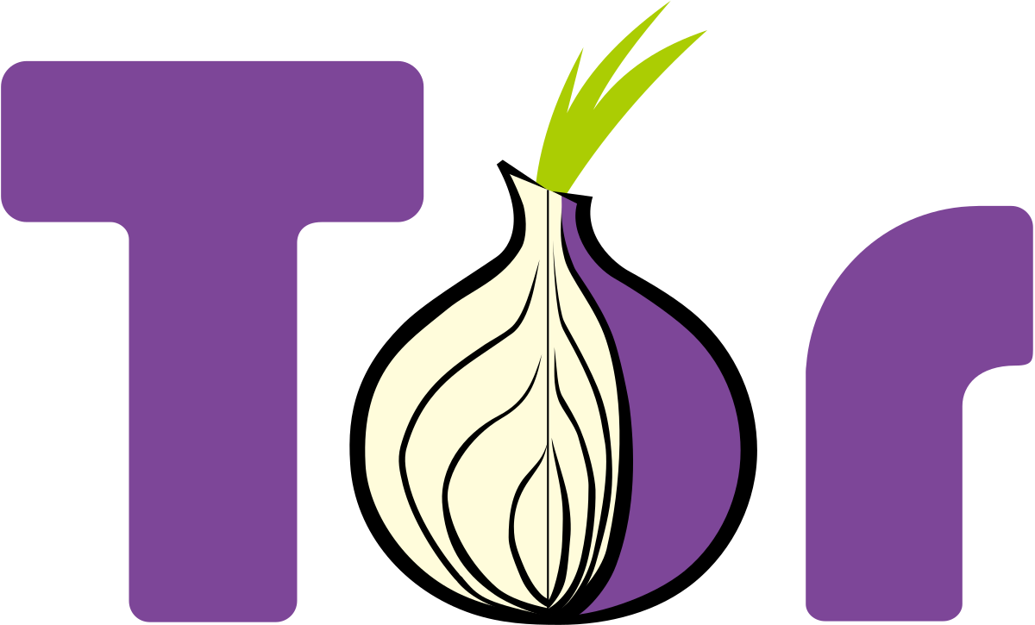
2a. What is the Dark Web and why does it matter?
(Relating to Cybersecurity)
Difficult to access
Access is through different browsers
Needs encryption software
Is a Cybersecurity concern
Offers hacking knowledge
Can host illegal content
[2]
Notes:
The dark web is network of networks which is at the most gated/hardest of networks to get into. In order to use the dark web, you need a browser like Tor to connect you and to tunnel your traffic through multiple geosites. You often need a VPN as another layer of safety on the Dark web. The Dark Web has knowledge not found on any other part of the internet, including hacking knowledge, and even illegal content. This makes the dark web a cybersecurity concern to professionals. That is mainly because the dark web is where many cyber crimes/crimes are committed on the network. [2]

Slide 5
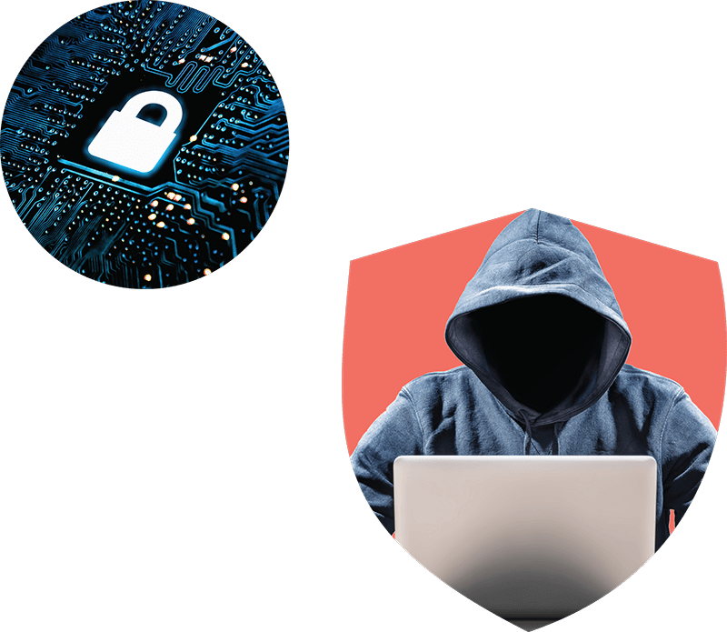
2b. What is the Dark Web and why does it matter?
(Relating to Cybersecurity)
The Dark Web is a huge concern for cyber professionals
Learning tool for Cyber professionals
Intelligence tool
It’s a subset of the entire cyber world
Where cyber criminals/criminals live
[2]
Notes:
The dark web matters in relation to cybersecurity because the dark web makes up a huge subset of the entire internet. The dark web is a place to where cyber criminals and criminals in general live and exchange services. It is a cyber forensics specialists and cyber officers job to have to use the dark web for the job that they do. Relating to learning cybersecurity information, the dark web is a great tool to find forums sharing hacking knowledge. They also share other information that can used for cyber intelligence purposes. The cyber security world benefits from the dark web by also being able to track trends of cyber criminals and the state of hacking.[2]

Slide 6

3a. Why should organizations care?
(About the dark web)
Customer data is vulnerable to the dark web
There are legal troubles with breaches
Insider threats can live here
[3]
Notes:
Organizations should care about the dark web because it’s a place where their business can become compromised. Consumer data that relates to their business can be sold and held at auctions on the dark web and they can be held liable by the government (FISMA, PCI DSS, HIPAA, GLBA). They are also insider threats on the dark web in relation to their organizations; internal employees can be committing treason. [3]

Slide 7
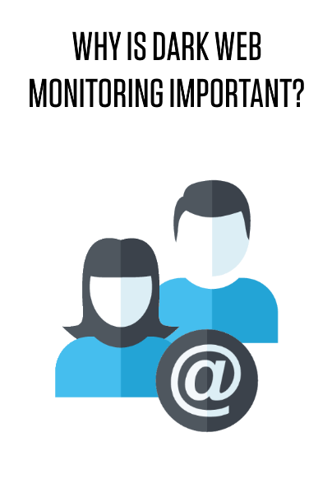
3b. Why should organizations care?
(About the dark web)
Industrial espionage on the dark web
Their business being attacked
Aids cyber professionals to threat hunt
[3]
Notes:
Organizations should also care about the dark web because they are able to detect industrial espionage that may be happening against their organization. They should also care about it because it allows their cybersecurity team to work better at their job and threat hunt better with access to more resources. Businesses should also be more aware of the dark web and care about it for overall cyber awarenes. [3]

Slide 8
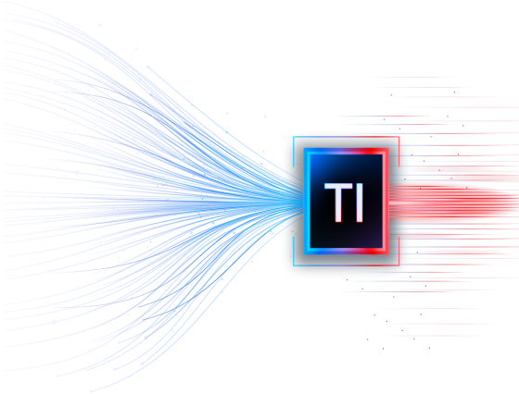
4a. How could the Dark Web be used by organizations for cyber intelligence?
Extract threat intelligence
Cyber awareness/improvement
Predict, identify, and protect
[4]
Notes:
The dark web could aid organizations for cyber intelligence in many ways. The state of cybersecurity at organizations is reliant on threat intelligence in one way or another. Awareness of the dark web can only help organizations. It allows them to be able to extract threat intelligence. The dark web also allows organizations to be more cyber aware of what resources and people are out there behind the scenes of crime and other online presence not on indexed sites. It also aids organizations in being able to predict, identify, and protect their business in many ways more than one. [4]

Slide 9

4b. How could the Dark Web be used by organizations for cyber intelligence?
Add to their threat intelligence pool
Go undercover
Understand criminal behavior
[5]
Notes:
The dark web is a great place for organizations to be able to learn from criminals and add to their knowledge of threats, understand them, and prevent them from attacking their business. The dark web is a great place to go undercover and learn more about criminals. It is also a great place for an organization to understand why criminals do what they do and their motives: cyber psychology. [5]

Slide 10

5a. Use cases for using the Dark Web within organizations
Detect data leaks within the dark web
Allows them to prevent a breach of customer data
Alert when organization name is mentioned on the dark web
[6]
Notes:
For a business to give customers comfort of mind, they need to protect their data in every way that they can. One way to do this is to use the dark web and find data leaks of customer data before it’s sold by criminals and used for malicious purposes. In the same way they can prevent a breach of customer data by tracking criminals on the dark web. Organizations are able to use dark web information that security service providers like DarkOwl analyze and create alerts when organizations names are mentioned on the dark web.[6]

Slide 11

5b. Use cases for using the Dark Web within organizations
For federal organizations (FBI, etc), find criminals
Track criminals on the dark web
Identify criminals on the dark web
Notes:
For federal organizations that handle or deal with crime, the dark web is a great resource. The dark web can help organizations just as the FBI track criminals engaging in criminal activity. The dark web can help identify criminals that share information about themselves on the darkweb with other criminals. Federal organizations are able to go undercover, join criminal forums, and find long time most wanted people on the dark web. From drug crime to identity theft, most of the criminals the FBI finds are through the dark web.

Slide 12
References
[1] https://www.netscout.com/what-is/difference-between-threat-intelligence-and-cybersecurity
[2] https://onlinedegrees.und.edu/blog/understanding-the-dark-web/
[3] https://www.ezcomputersolutions.com/blog/what-is-the-dark-web-and-why-should-small-businesses-care/
[4] https://flare.systems/learn/resources/blog/dark-web-threat-intelligence/
[5] https://www.authentic8.com/blog/understanding-dark-web-and-how-it-can-aid-your-investigation
[6]https://www.trustwave.com/en-us/resources/blogs/trustwave-blog/how-the-dark-web-can-give-organizations-actionable-insights/

